Slide 1
Visualizing the Distribution of a Variable
R. Garner, DePaul University

Slide 2
Visualizing variable distributions = graphing
We want to summarize and visualize the distribution of a variable, which usually means graphing it in a way that shows how many cases (frequencies) there are for the values in the range.
The short version:
  If it is a categorical variable, show the frequencies (count or proportion of cases) for each categorical value.
  If it is a numerical variable, two options are:
    The histogram
    The boxplot

Slide 3
Categorical variables (nominal or ordinal)
For each value (i.e., category) of the variable, show a vertical bar that represents the frequencies (count or proportion of cases) at that value.
The height of the bar shows how many cases (as a count or proportion of cases) there are for that specific value.
Examples of variables we could display in a bar chart: religious affiliations of college students (nominal); percent of Canadian residents of specific ethnicities (nominal); how many respondents in a survey drank coffee this morning and how many did not (binary); how many dresses in the large, medium, and small categories were sold today (ordinal).

Slide 4
Example: How do students fulfill reading assignments? (from Study Habits data set)

Slide 5
Interpreting the bar chart
In the previous slide we can see that 31 students reported shortcuts like skimming or reading an online summary.
8 students said they usually do not do the reading (“nothing”).
10 students said they usually do all the reading (“all”).
This is a very simple, easy-to-read bar chart. Each bar is associated with one of the three values of the variable. The height of the bars represents the counts. Each bar is marked with the count for the value.
We could have labeled the bar heights (frequencies) with percentages. Of the 49 students who responded: 31/49 = 63.3% said “shortcuts,” 8/49 = 16.3% said “nothing,” and 10/49 = 20.4% said “all.”

Slide 6
Reminder: Only one variable in this bar chart
The Read bar chart is a graph of the distribution of just ONE variable.
We could make a two-variable bar chart—for example, showing the frequencies of the READ values (all, nothing, shortcuts) for specific categories of respondents categorized by GENDER (men, women, non-binary). Each of the GENDER categories (a predictor variable) would have three bars displayed, one for each of the READ categories.
This two-variable bar chart would help us see whether people of different genders have different reading habits.

Slide 7
Histograms
We usually make histograms for variables that are:
  Genuinely continuous (we can subdivide the measurement intervals indefinitely): for example, height.
  Close enough to be treated as continuous: for example, income in dollars and cents. (OK, we can’t subdivide cents, but for most practical purposes this variable is continuous.)
  Discrete values—but there are so many of them with such a large range that it is simpler to use a histogram rather than a bar chart: for example, leaves on trees, fleas on dogs.

Slide 8
When we make a histogram, we treat the variable as continuous
A histogram looks like a bar chart, but the vertical bars are “smooshed together.” The values along the horizontal axis are NOT discrete values or distinct categories, they are just a set of numbers along the continuous number line.
Either we or our software decides how to break up the continuous number line to decide where to place the vertical bars that display frequencies.
Examples: heights of students at a university; square meters of apartment space for a sample of Toronto apartments; income in pounds-sterling for residents of the UK.

Slide 9
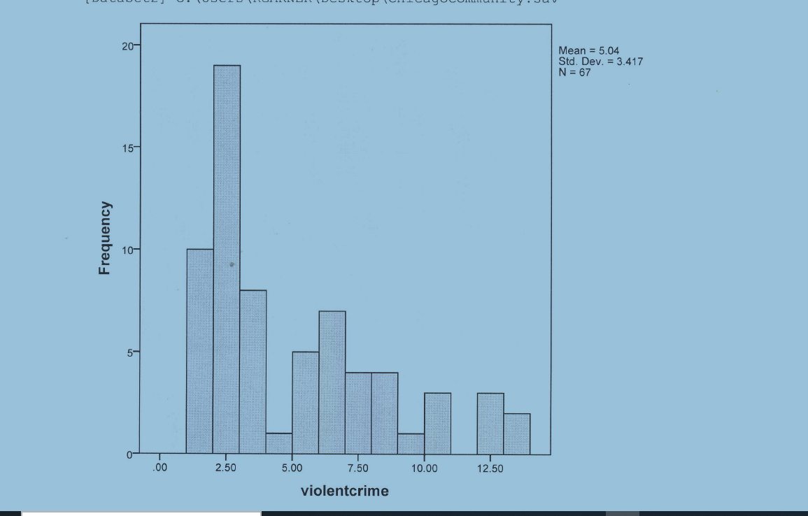
Example: Violent crime rates in Chicago community areas

Slide 10
Interpreting the histogram
This histogram displays violent crime rates in Chicago community areas.
Although there are 77 areas, the violent crime rates are available for only 67 (upper right-hand corner of the graph).
The software has selected the values for us, the violent crime rates per 100,000 residents, and plotted them across the horizontal axis.
The mode is 2.6 violent crimes per 100,000 residents, and the modal frequency looks to be about 18—the highest bar.
Most areas have relatively low rates; only a few have high ones, over 10 violent crimes per 100,000 residents.
This variable shows positive skew: many areas with rather low rates, smaller numbers with high rates. The mean crime rate is 5 per 100,000 residents, but remember—with positive skew, the mean is higher than the median (which might be a better measure for this variable).

Slide 11
Boxplot
The boxplot is a little tougher to “get” than the bar chart and histogram, but it is very popular now.
It shows us the values that are associated with cases at the various percentiles of the distribution—the 50th percentile (that value is called the median), the 25th and 75th percentiles (those two values mark the Interquartile Range, IQR) and the very top and bottom of the distribution.
The values are plotted in the vertical dimension and the associated percentiles are then marked, with a dark horizontal line for the median and box for the IQR.

Slide 12
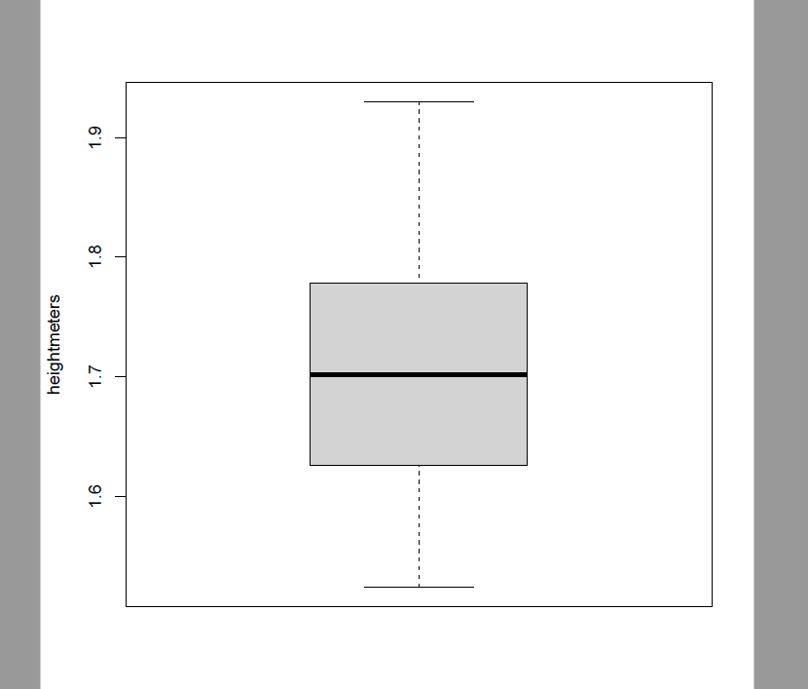
Boxplot: Heights (180 students data set)

Slide 13
Boxplot: Interpretation
This is a very simple “bare bones” boxplot created using R-Commander. We have to guess a little because the scale on the left is rather sketchy, with not a lot of values filled in.
We can see the median height (look at the scale on the left and see how it lines up with the dark line through the middle of the box)—it is about 1.7 meters.
At the 25th percentile (so, the height at the border of the shortest 45 people in the sample and the next person up), the height is about 1.62.
At the 75th percentile, the height is about 1.78.
The tallest person in the sample is over 1.9 meters tall—marked by the “whisker” at the top of the box.

Slide 14
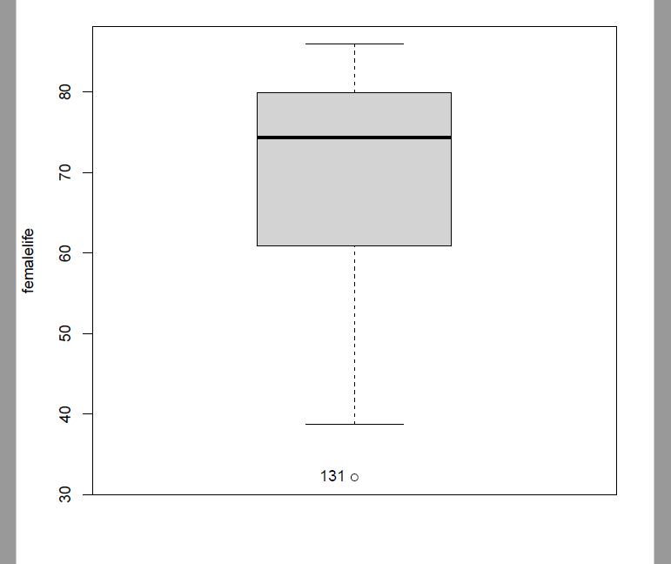
Boxplot: Female life expectancy

Slide 15
Interpretation
The boxplot on the previous slide shows the female life expectancy for countries.
It might look strange to see the median value (the one on the left side at the level of the dark horizontal bar) NOT in the middle of the box. You can see that it is at about 76 years.
The median is high in this graph because the 50% of countries with high female life expectancy have life expectancies in a rather compressed range of ages. They have life expectancies between 75 and 85 years of age.
Countries below the median have a larger range of life expectancy.
From the 25th percentile value (lower edge of the box) to the median is a range of about 60 to 75 years.
The lowest life expectancy—marked by a small dot—is from a small country in Southern Africa called Eswatini, with a female life expectancy of only 31 years because of the AIDS epidemic at the time the data was collected. (The number 131 at the small dot is the case number of the country in the data set, NOT the life expectancy.)

Slide 16
Boxplots and skew
When we see the boxplot, we can see positive and negative skew, just as we can from the histogram.
Positive skew is revealed by a median that is relatively LOW in the graph; the large range of high values appears above it. (Many cases have low values, a few have high values.)
Negative skew, as in the female life expectancy boxplot, is revealed by a median that is HIGH in the graph. A large range of low values appears below it. (Many cases have high values, only a few have low values.)
The height boxplot with a median near the middle of the graph (and of the IQR box) shows a near-normal distribution.

Slide 17
Two-variable boxplots
We can display the distribution of a NUMERICAL variable for each of the different categories of a CATEGORICAL variable; each category of the categorical predictor variable gets its own boxplot for the numerical variable, and all are aligned with the numerical values on the left side.
For example, we could show four separate boxplots of female life expectancy for the countries in the four income categories used by the World Bank: low income, lower-middle income, upper-middle income, and high income.
What do you think these four boxplots would look like?

Slide 18
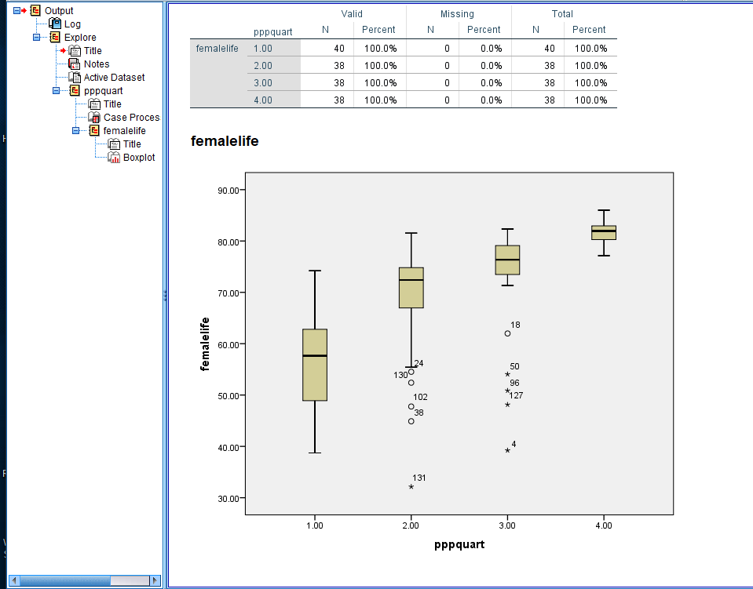
Boxplots: Female life expectancy by income quartile

Slide 19
Interpretation of the boxplots
In the preceding slide we can see four boxplots. Each boxplot shows the distribution of female life expectancy for a group of countries. Countries were put into four ordinal categories depending on which quartile of the income distribution they fell into. This ordinal categorical variable was called PPPQUART and the code numbers from 1 to 4 were assigned and marked across the bottom of the graph.
We can immediately see that countries in the richest quartile had the highest female life expectancies and a very compressed range.
Countries in the poorest quartile had the lowest life expectancies and the lowest median.
The countries in the two intermediate income categories had rather large ranges of life expectancies and intermediate medians.

Slide 20
What happened to the pie chart?
The pie chart is a way of showing the same information as the one-variable bar chart, but it has fallen out of favor…

